Slide 1
Lecture 3: Regularization and Optimization

Slide 2
Outline
Regularization of NN
Norm Penalties
Early Stopping
Data Augmentation
Bagging
Dropout
Optimization
Challenges in Optimization
Momentum
Adaptive Learning Rate
Parameter Initialization
Batch Normalization

Slide 3
Outline
Regularization of NN
Norm Penalties
Early Stopping
Data Augmentation
Bagging
Dropout
Optimization
Challenges in Optimization
Momentum
Adaptive Learning Rate
Parameter Initialization
Batch Normalization

Slide 4
Regularization
Regularization is any modification we make to a learning algorithm that is intended to reduce its generalization error but not its training error.

Slide 5
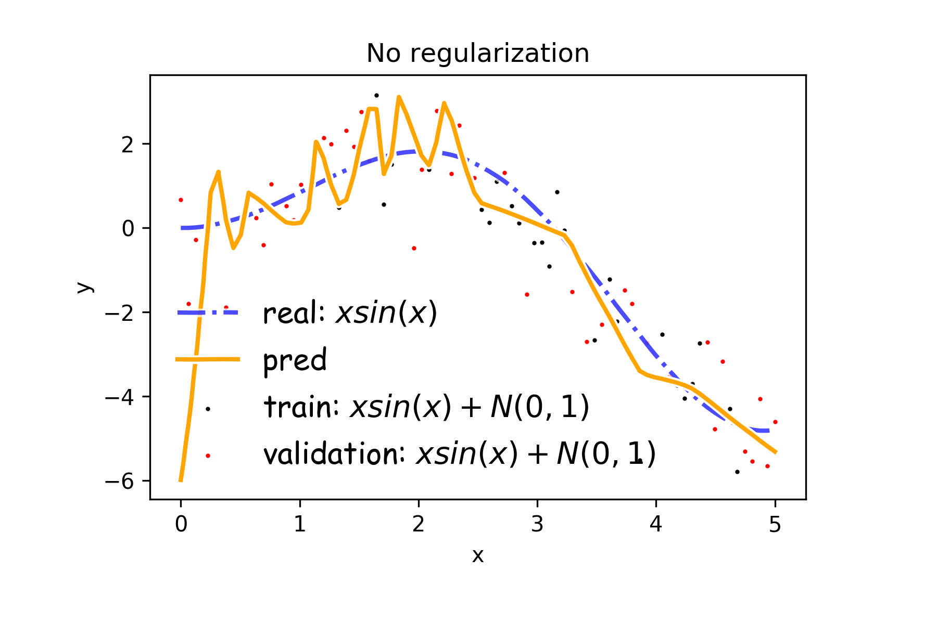
Overfitting
Fitting a deep neural network with 5 layers and 100 neurons per layer can lead to a very good prediction on the training set but poor prediction on validations set.

Slide 6
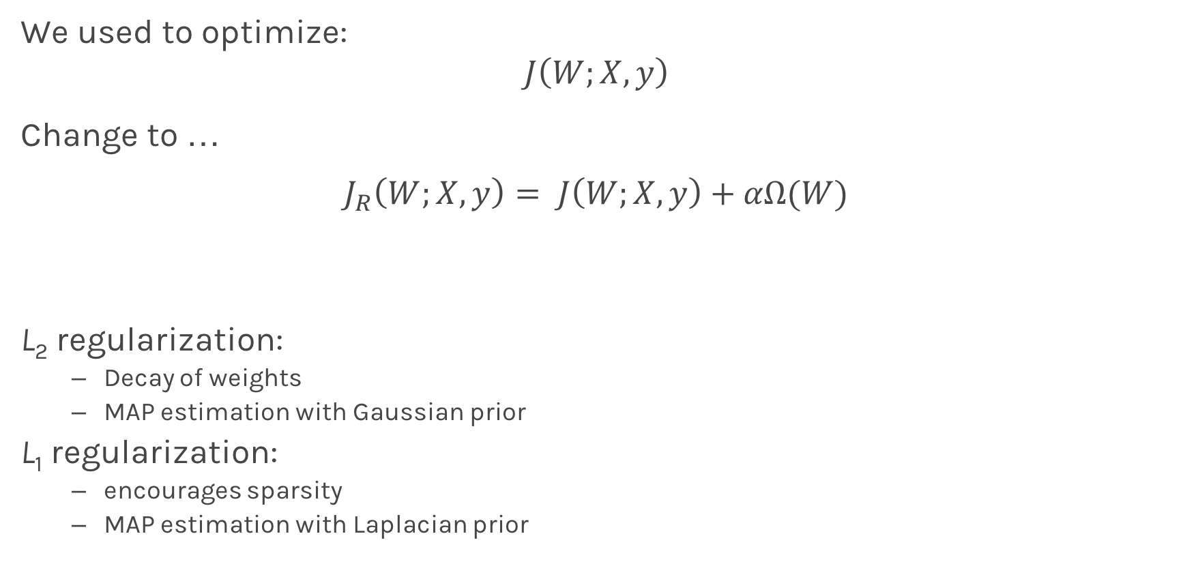
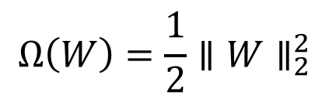
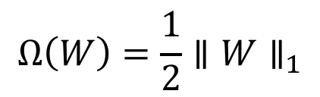
Norm Penalties
We used to optimize:
$$J\left(W;X, y\right)$$
Change to …
$$J_{R}\left(W;X,y\right)= J\left(W;X, y\right)+αΩ(W)$$
L₂ regularization:
Decay of weights
MAP estimation with Gaussian prior
L₁ regularization:
encourages sparsity
MAP estimation with Laplacian prior
Biases not penalized
$$Ω\left(W\right)=\frac{1}{2}∥W∥_{2}^{2}$$
$$Ω\left(W\right)=\frac{1}{2}∥W∥_{1}$$

Slide 7
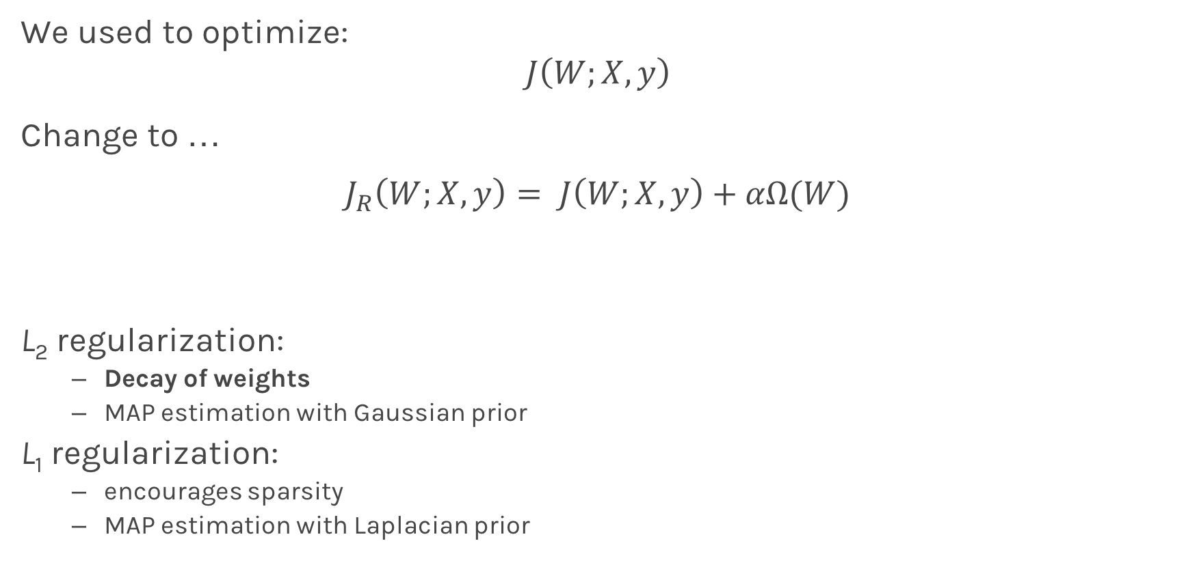
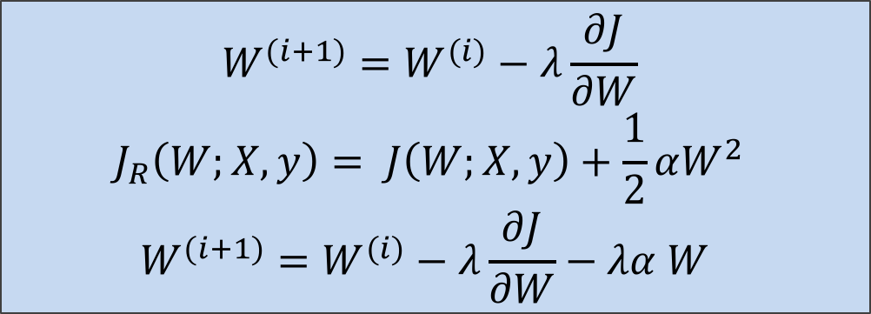
Norm Penalties
weights decay in proportion to its size.
We used to optimize:
$$J\left(W;X, y\right)$$
Change to …
$$J_{R}\left(W;X,y\right)= J\left(W;X, y\right)+αΩ(W)$$
L₂ regularization:
Decay of weights
MAP estimation with Gaussian prior
L₁ regularization:
encourages sparsity
MAP estimation with Laplacian prior
$$W^{(i+1)}=W^{(i)}−λ\frac{∂J}{∂W} \\ J_{R}\left(W;X,y\right)= J\left(W;X, y\right)+\frac{1}{2}αW^{2} \\ W^{(i+1)}=W^{(i)}−λ\frac{∂J}{∂W}−λα W$$
Biases not penalized
$$Ω\left(W\right)=\frac{1}{2}∥W∥_{2}^{2}$$
$$Ω\left(W\right)=\frac{1}{2}∥W∥_{1}$$

Slide 8
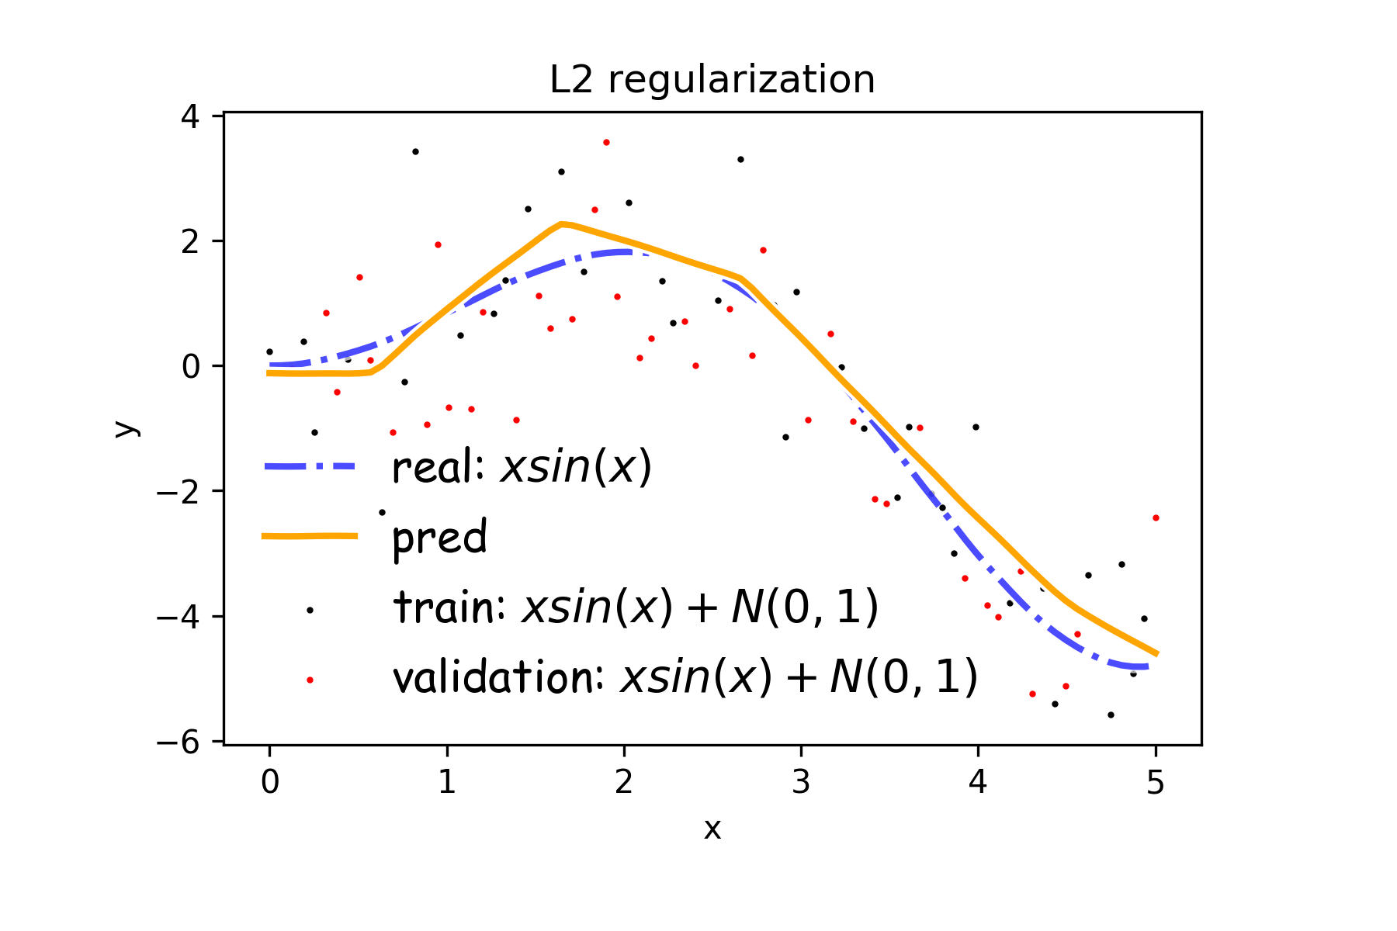
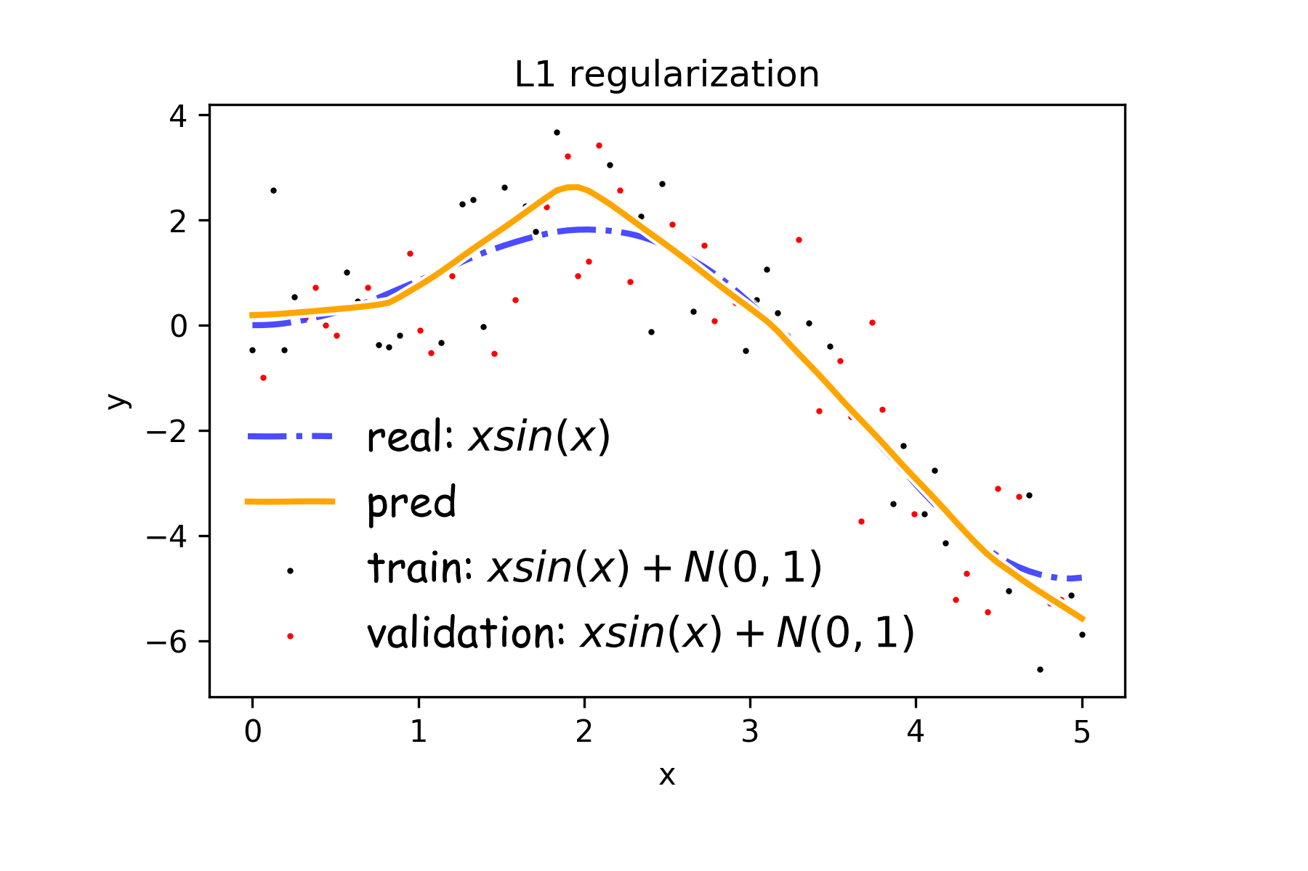
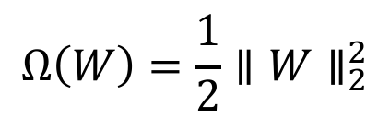
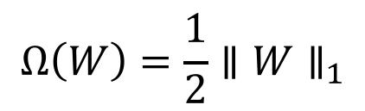
Norm Penalties
$$Ω\left(W\right)=\frac{1}{2}∥W∥_{2}^{2}$$
$$Ω\left(W\right)=\frac{1}{2}∥W∥_{1}$$

Slide 9
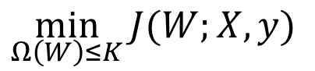
Norm Penalties as Constraints
$$\min_{Ω\left(W\right)≤K}{J(W;X,y)}$$
Useful if K is known in advance
Optimization:
Construct Lagrangian and apply gradient descent
Projected gradient descent

Slide 10
Outline
Regularization of NN
Norm Penalties
Early Stopping
Data Augmentation
Bagging
Dropout
Optimization
Challenges in Optimization
Momentum
Adaptive Learning Rate
Parameter Initialization
Batch Normalization

Slide 11
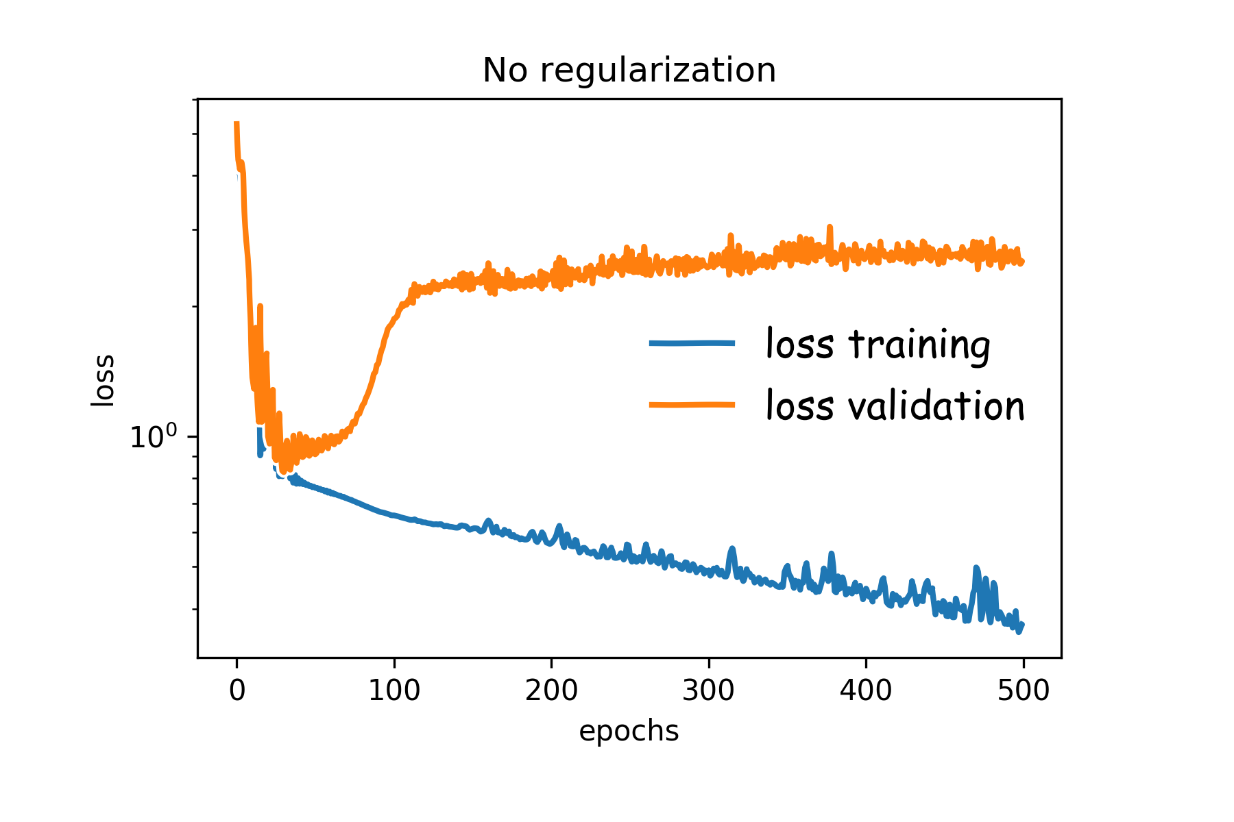
Early Stopping
Early stopping: terminate while validation set performance is better
Training time can be treated as a hyperparameter

Slide 12
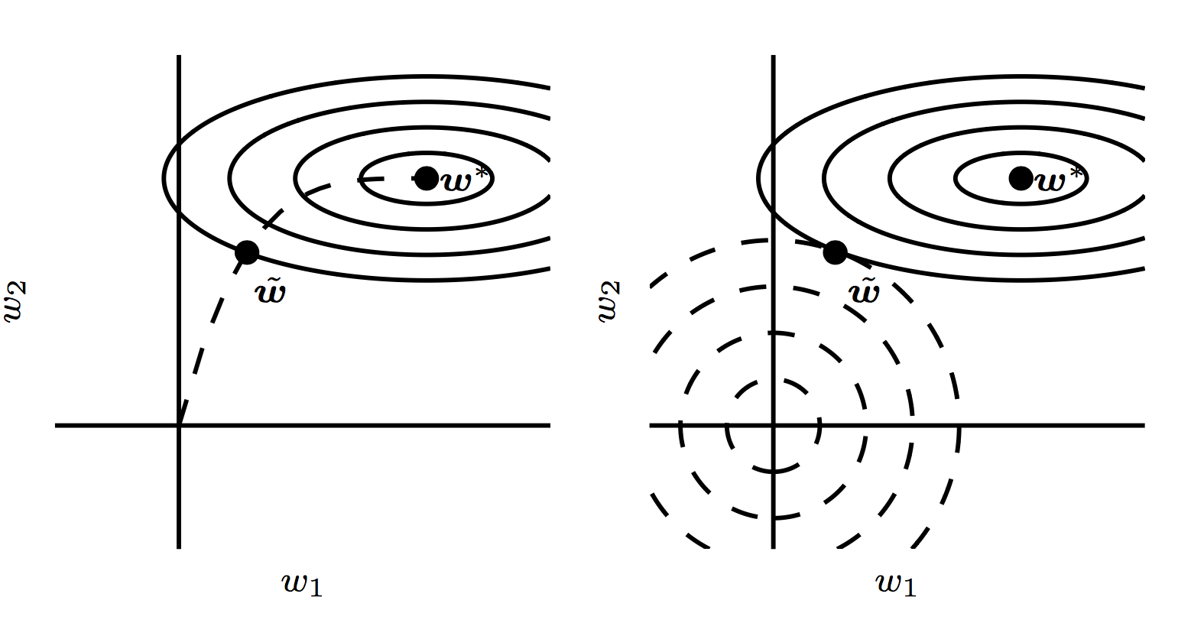
Early Stopping

Slide 13
Outline
Regularization of NN
Norm Penalties
Early Stopping
Sparse Representation
Data Augmentation
Bagging
Dropout
Optimization
Challenges in Optimization
Momentum
Adaptive Learning Rate
Parameter Initialization
Batch Normalization

Slide 14
Sparse Representation

Slide 15
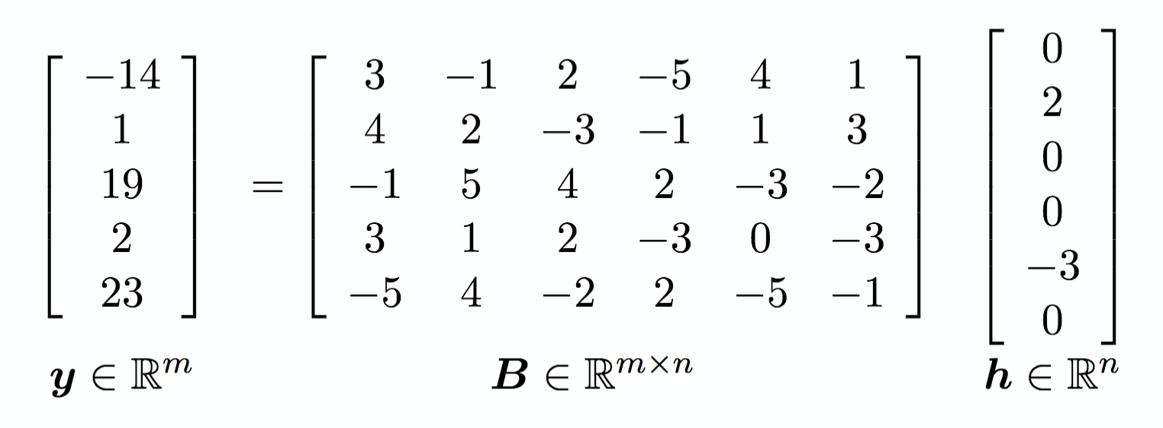
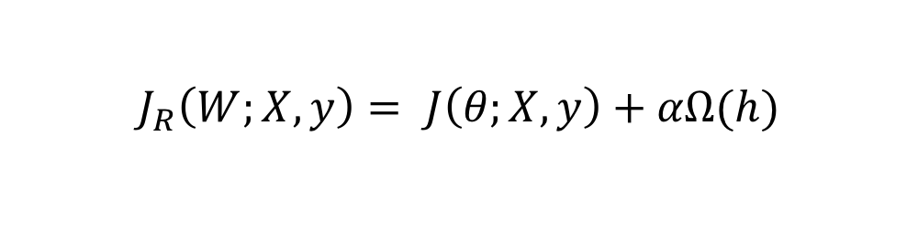
Sparse Representations
Weight decay on activations instead of parameters
Output of hidden layer
Weights in output layer
$$J_{R}\left(W;X,y\right)= J\left(θ;X, y\right)+αΩ(h)$$

Slide 16
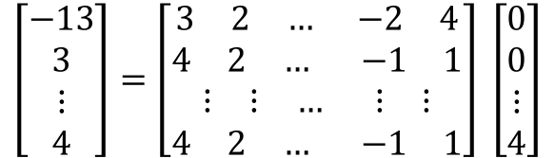
$$\left[\begin{aligned}−13 \\ 3 \\ ⋮ \\ 4\end{aligned}\right]=\left[\begin{aligned}\begin{matrix}3 & 2 & …\end{matrix}\begin{matrix} & −2 & 4\end{matrix} \\ \begin{matrix}4 & 2 & …\end{matrix} \begin{matrix} & −1 & 1\end{matrix} \\ \begin{matrix}⋮ & ⋮ & …\end{matrix} \begin{matrix} & ⋮ & ⋮\end{matrix} \\ \begin{matrix}4 & 2 & …\end{matrix} \begin{matrix} & −1 & 1\end{matrix}\end{aligned}\right] \left[\begin{aligned}0 \\ 0 \\ ⋮ \\ 4\end{aligned}\right]$$

Slide 17
Outline
Regularization of NN
Norm Penalties
Early Stopping
Data Augmentation
Bagging
Dropout
Optimization
Challenges in Optimization
Momentum
Adaptive Learning Rate
Parameter Initialization
Batch Normalization

Slide 18
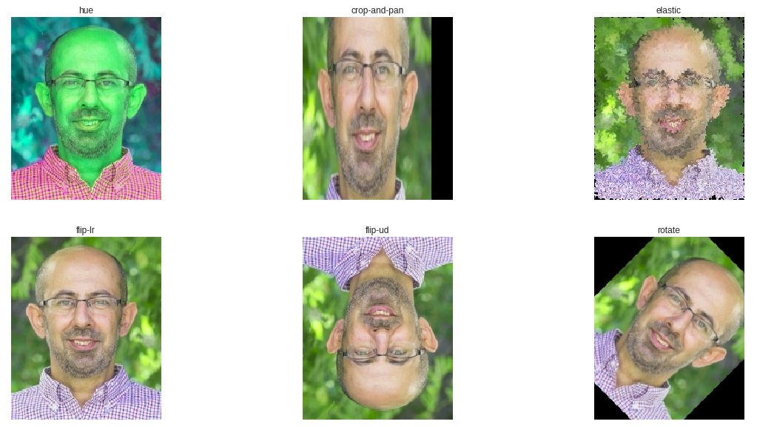
Data Augmentation

Slide 19
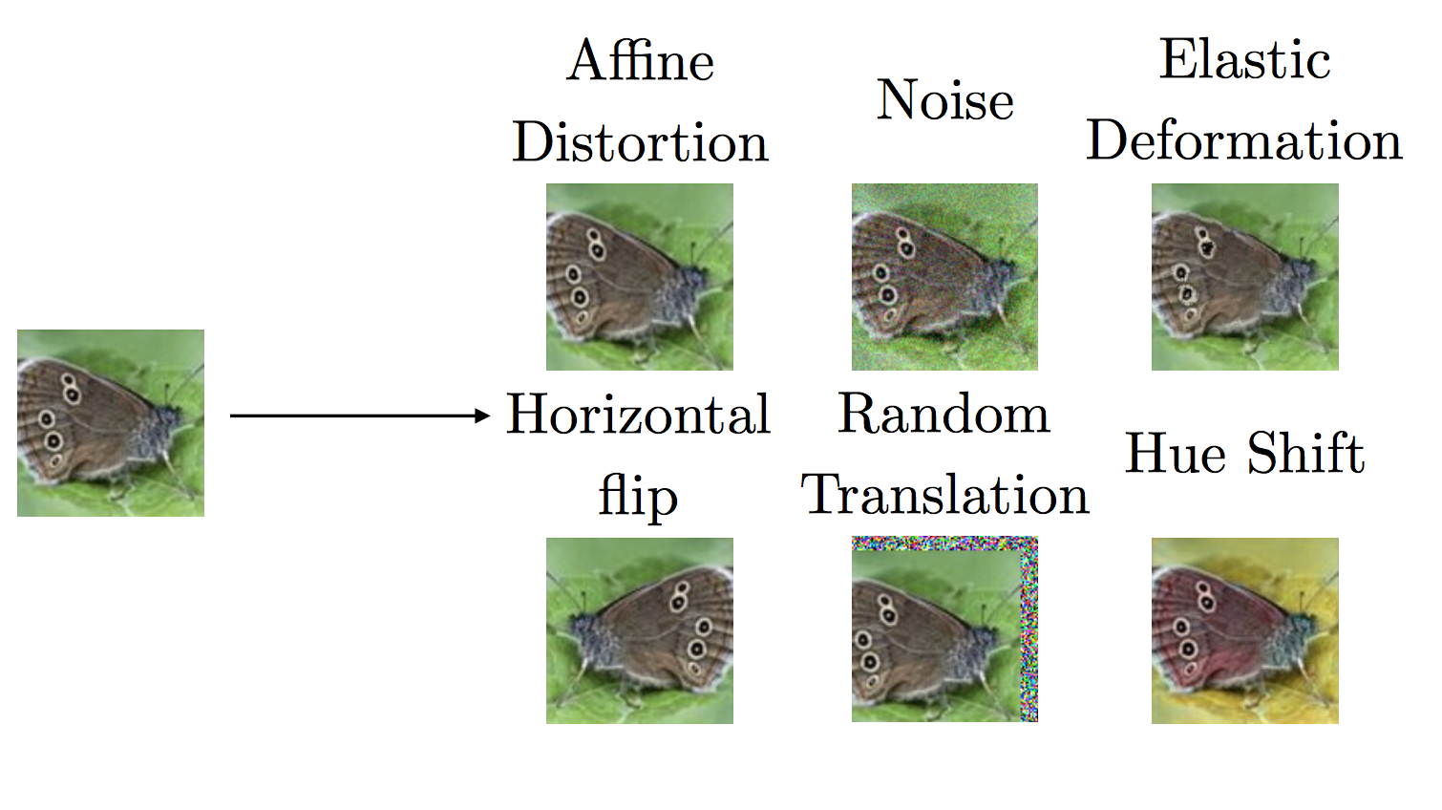
Data Augmentation

Slide 20
Outline
Regularization of NN
Norm Penalties
Early Stopping
Data Augmentation
Bagging
Dropout
Optimization
Challenges in Optimization
Momentum
Adaptive Learning Rate
Parameter Initialization
Batch Normalization

Slide 21

Noise Robustness
Random perturbation of network weights
Gaussian noise: Equivalent to minimizing loss with regularization term
Encourages smooth function: small perturbation in weights leads to small changes in output
Injecting noise in output labels
Better convergence: prevents pursuit of hard probabilities
$$𝔼[∥∇_{W}y\left(x\right)∥]$$

Slide 22
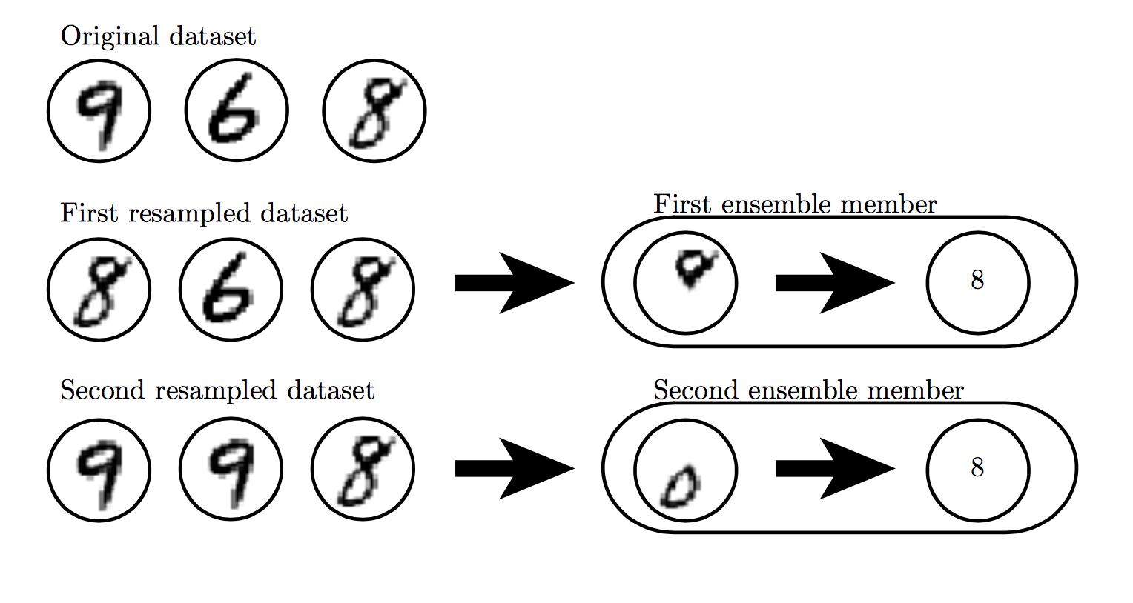

Slide 23
Outline
Regularization of NN
Norm Penalties
Early Stopping
Data Augmentation
Bagging
Dropout
Optimization
Challenges in Optimization
Momentum
Adaptive Learning Rate
Parameter Initialization
Batch Normalization

Slide 24
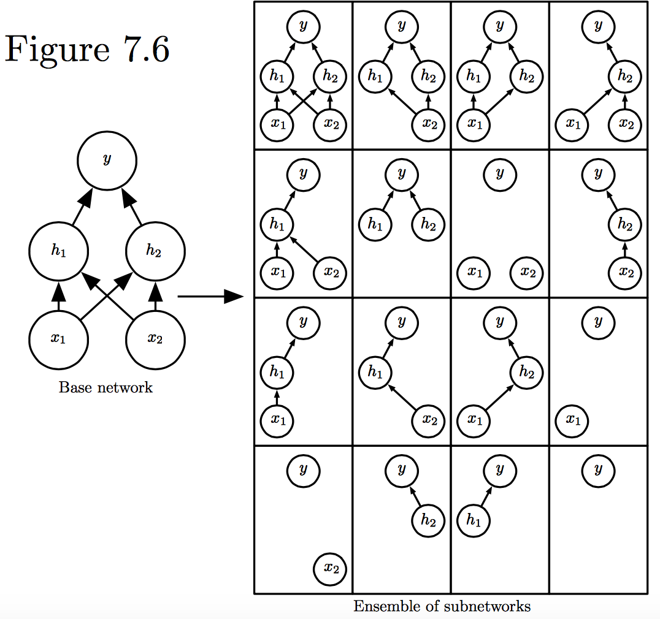
Dropout
Train all sub-networks obtained by removing non-output units from base network

Slide 25
Dropout: Stochastic GD
For each new example/mini-batch:
Randomly sample a binary mask μ independently, where μ_{i} indicates if input/hidden node i is included
Multiply output of node i with μ_{i}, and perform gradient update
Typically, an input node is included with prob=0.8, hidden node with prob=0.5.

Slide 26
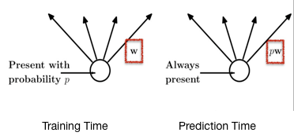
Dropout: Weight Scaling
During prediction time use all units, but scale weights with probability of inclusion
Notes:
https://chatbotslife.com/regularization-in-deep-learning-f649a45d6e0

Slide 27
Adversarial Examples

Slide 28


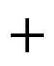
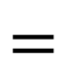
Adversarial Examples
$$+$$
$$=$$
Panda 57% confidence
noise
Gibbon 99.3% confidence
Training on adversarial examples is mostly intended to improve security, but can sometimes provide generic regularization.

Slide 29
Outline
Regularization of NN
Norm Penalties
Early Stopping
Data Augmentation
Bagging
Dropout
Optimization
Challenges in Optimization
Momentum
Adaptive Learning Rate
Parameter Initialization
Batch Normalization

Slide 30
Optimization

Slide 31
Learning vs. Optimization
Goal of learning: minimize generalization error
In practice, empirical risk minimization:
Quantity optimized different from the quantity we care about

Slide 32
Batch vs. Stochastic Algorithms
Batch algorithms
Optimize empirical risk using exact gradients
Stochastic algorithms
Estimates gradient from a small random sample
Large mini-batch: gradient computation expensive
Small mini-batch: greater variance in estimate, longer steps for convergence

Slide 33
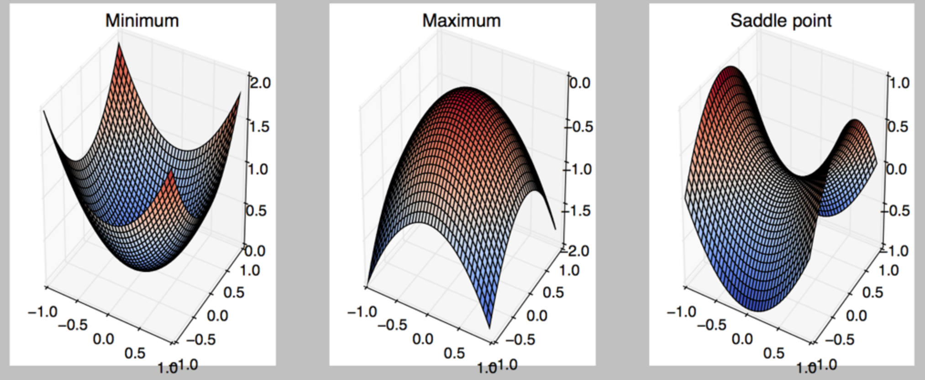
Critical Points
Points with zero gradient
2nd-derivate (Hessian) determines curvature
Goodfellow et al. (2016)

Slide 34
Stochastic Gradient Descent
Take small steps in direction of negative gradient
Sample m examples from training set and compute:
Update parameters:
In practice: shuffle training set once and pass through multiple times

Slide 35
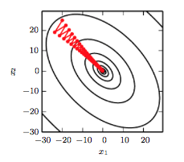
Stochastic Gradient Descent
Oscillations because updates do not exploit curvature information
Goodfellow et al. (2016)

Slide 36
Outline
Regularization of NN
Norm Penalties
Early Stopping
Data Augmentation
Bagging
Dropout
Optimization
Challenges in Optimization
Momentum
Adaptive Learning Rate
Parameter Initialization
Batch Normalization

Slide 37
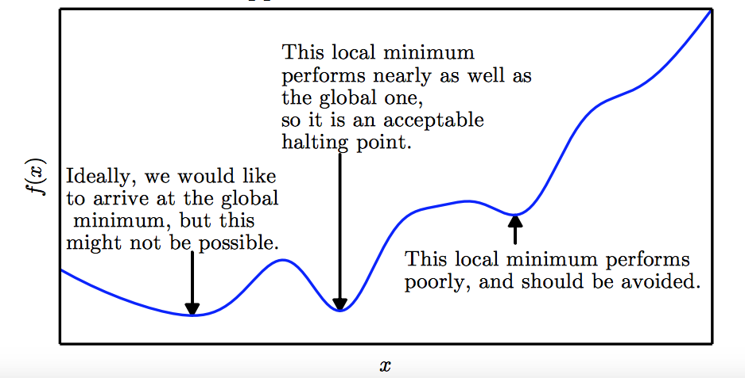
Local Minima
Goodfellow et al. (2016)

Slide 38
Local Minima
Old view: local minima is major problem in neural network training
Recent view:
For sufficiently large neural networks, most local minima incur low cost
Not important to find true global minimum

Slide 39
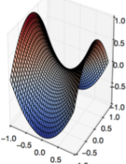
Saddle Points
Both local min and max
Recent studies indicate that in high dim, saddle points are more likely than local min
Gradient can be very small near saddle points
Goodfellow et al. (2016)

Slide 40
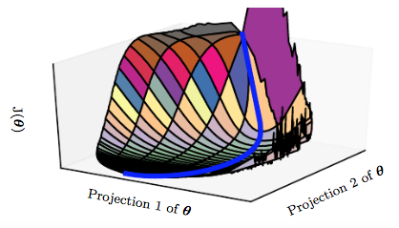
Saddle Points
SGD is seen to escape saddle points
Moves down-hill, uses noisy gradients
Second-order methods get stuck
solves for a point with zero gradient
Goodfellow et al. (2016)

Slide 41
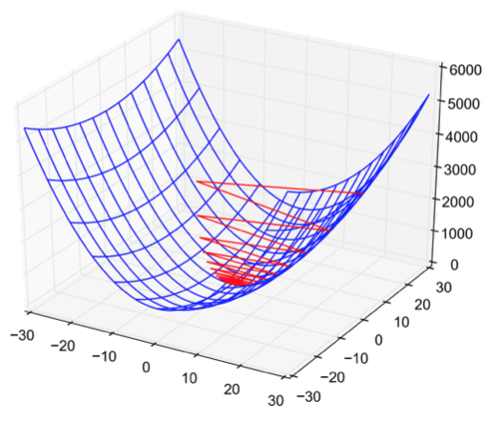
Poor Conditioning
Poorly conditioned Hessian matrix
High curvature: small steps leads to huge increase
Learning is slow despite strong gradients
Oscillations slow down progress

Slide 42
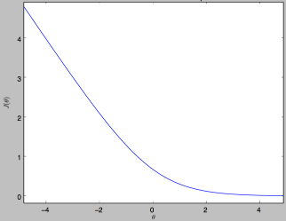
No Critical Points
Some cost functions do not have critical points. In particular classification.

Slide 43
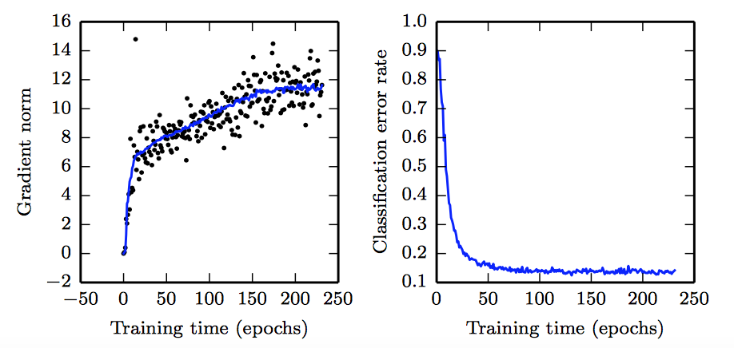
No Critical Points
Gradient norm increases, but validation error decreases
Convolution Nets for Object Detection
Goodfellow et al. (2016)

Slide 44
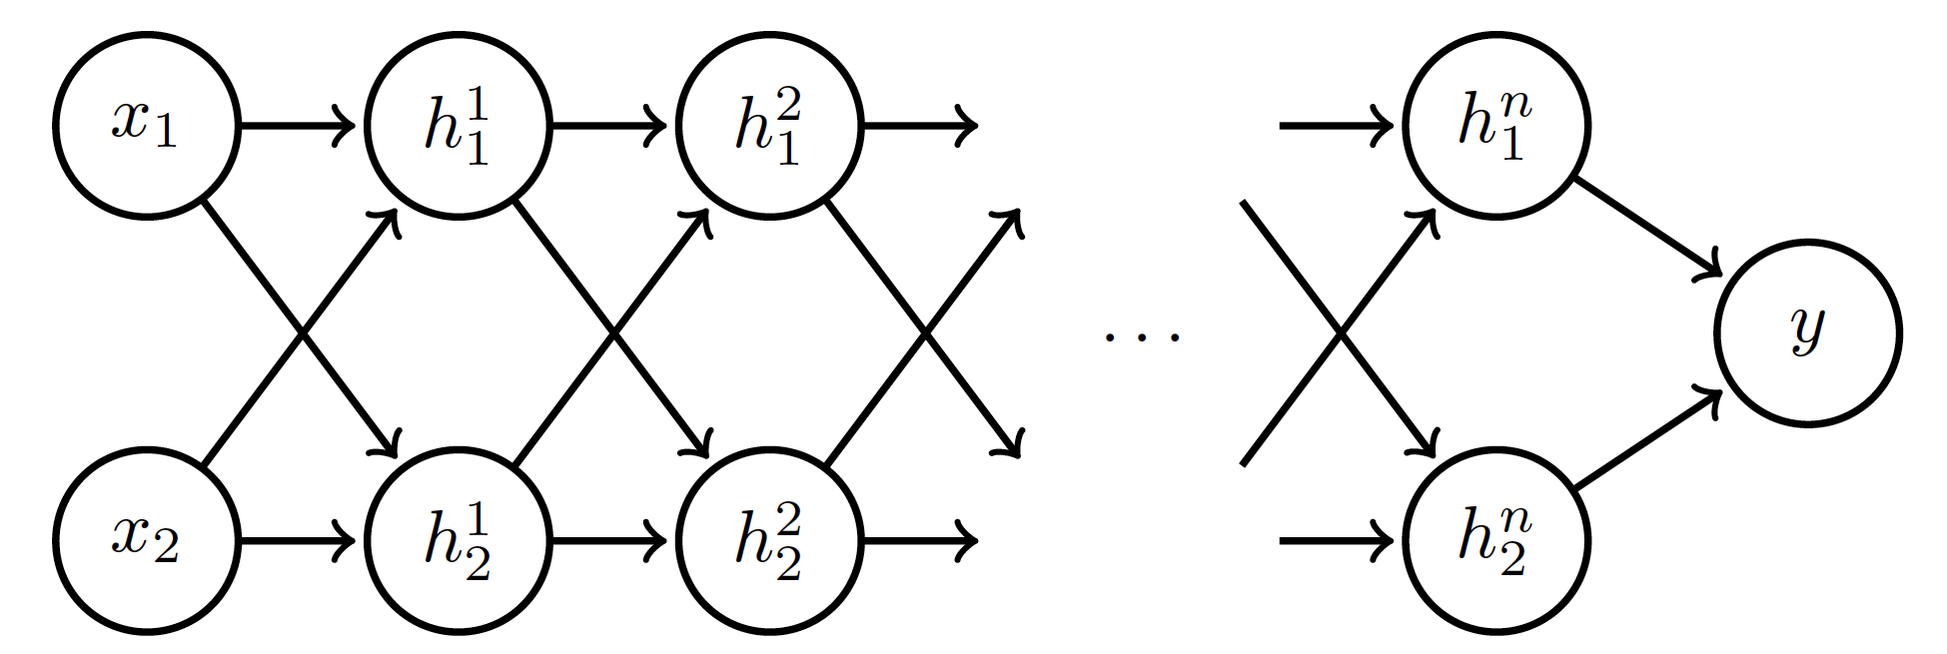
Exploding and Vanishing Gradients
Linear activation
deeplearning.ai

Slide 45
Exploding and Vanishing Gradients

Slide 46
Exploding and Vanishing Gradients
Explodes!
Vanishes!

Slide 47
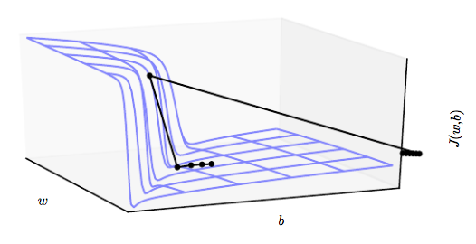
Exploding and Vanishing Gradients
Exploding gradients lead to cliffs
Can be mitigated using gradient clipping
Goodfellow et al. (2016)

Slide 48
Outline
Regularization of NN
Norm Penalties
Early Stopping
Data Augmentation
Bagging
Dropout
Optimization
Challenges in Optimization
Momentum
Adaptive Learning Rate
Parameter Initialization
Batch Normalization

Slide 49
Momentum
SGD is slow when there is high curvature
Average gradient presents faster path to opt:
vertical components cancel out
Notes:
https://distill.pub/2017/momentum/

Slide 50
Momentum
Uses past gradients for update
Maintains a new quantity: ‘velocity’
Exponentially decaying average of gradients:
Current gradient update
controls how quickly effect of past gradients decay

Slide 51
Momentum
Compute gradient estimate:
Update velocity:
Update parameters:

Slide 52
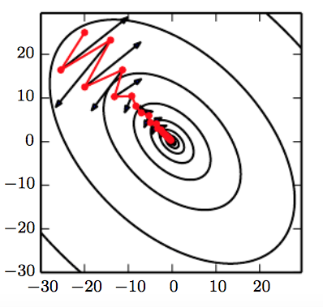
Momentum
Damped oscillations:
gradients in opposite directions get cancelled out
Goodfellow et al. (2016)

Slide 53
Nesterov Momentum
Apply an interim update:
Perform a correction based on gradient at the interim point:
Momentum based on look-ahead slope

Slide 54
Outline
Regularization of NN
Norm Penalties
Early Stopping
Data Augmentation
Bagging
Dropout
Optimization
Challenges in Optimization
Momentum
Adaptive Learning Rate
Parameter Initialization
Batch Normalization

Slide 55
Adaptive Learning Rates
Slow
Fast
Oscillations along vertical direction
Learning must be slower along parameter 2
Use a different learning rate for each parameter?

Slide 56
AdaGrad
Accumulate squared gradients:
Update each parameter:
Greater progress along gently sloped directions
Inversely proportional to cumulative squared gradient

Slide 57
RMSProp
For non-convex problems, AdaGrad can prematurely decrease learning rate
Use exponentially weighted average for gradient accumulation

Slide 58
Adam
RMSProp + Momentum
Estimate first moment:
Estimate second moment:
Update parameters:
Also applies bias correction to v and r
Works well in practice, is fairly robust to hyper-parameters

Slide 59
Outline
Regularization of NN
Norm Penalties
Early Stopping
Data Augmentation
Bagging
Dropout
Optimization
Challenges in Optimization
Momentum
Adaptive Learning Rate
Parameter Initialization
Batch Normalization

Slide 60
Parameter Initialization
Goal: break symmetry between units
so that each unit computes a different function
Initialize all weights (not biases) randomly
Gaussian or uniform distribution
Scale of initialization?
Large -> grad explosion, Small -> grad vanishing

Slide 61
Xavier Initialization
Heuristic for all outputs to have unit variance
For a fully-connected layer with m inputs:
For ReLU units, it is recommended:

Slide 62
Normalized Initialization
Fully-connected layer with m inputs, n outputs:
Heuristic trades off between initialize all layers have same activation and gradient variance
Sparse variant when m is large
Initialize k nonzero weights in each unit

Slide 63
Bias Initialization
Output unit bias
Marginal statistics of the output in the training set
Hidden unit bias
Avoid saturation at initialization
E.g. in ReLU, initialize bias to 0.1 instead of 0
Units controlling participation of other units
Set bias to allow participation at initialization

Slide 64
Outline
Challenges in Optimization
Momentum
Adaptive Learning Rate
Parameter Initialization
Batch Normalization

Slide 65
Feature Normalization
Good practice to normalize features before applying learning algorithm:
Features in same scale: mean 0 and variance 1
Speeds up learning
Feature vector
Vector of mean feature values
Vector of SD of feature values

Slide 66
Feature Normalization
Before normalization
After normalization

Slide 67
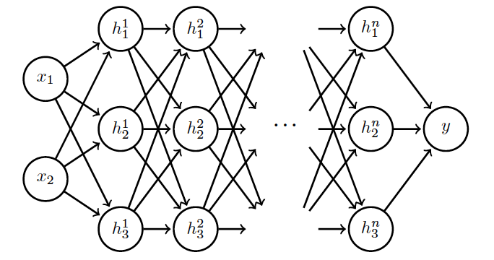
Internal Covariance Shift
Each hidden layer changes distribution of inputs to next layer: slows down learning
…
Normalize inputs to layer 2
Normalize inputs to layer n

Slide 68
Batch Normalization
Training time:
Mini-batch of activations for layer to normalize
K hidden layer activations
N data points in mini-batch

Slide 69
Batch Normalization
Training time:
Mini-batch of activations for layer to normalize
where
Vector of mean activations across mini-batch
Vector of SD of each unit across mini-batch

Slide 70
Batch Normalization
Training time:
Normalization can reduce expressive power
Instead use:
Allows network to control range of normalization
Learnable parameters

Slide 71
Batch Normalization
Batch 1
…..
Add normalization operations for layer 1
Batch N

Slide 72
Batch Normalization
Batch 1
…..
Add normalization operations for layer 2 and so on …
Batch N

Slide 73
Batch Normalization
Differentiate the joint loss for N mini-batches
Back-propagate through the norm operations
Test time:
Model needs to be evaluated on a single example
Replace μ and σ with running averages collected during training

